Slide 1

Write with Them
Michelle Jones
Assistant Principal and Teacher of English at The Duston School
@mjonesteach

Slide 2
Modelling and using visualisers
We “should focus more on practicing the 20 percent of things that create value than the other 80% of things”
MY DART project…
Modelling matters
Get better at it
“We are fond of saying “Practice makes perfect”…but it is more accurate to say that practice makes permanent”. (Lemov)

Slide 3
Modelling-the why
Because research tells us it matters…
“Students need cognitive support to help them to learn to solve problems. Modelling and the teacher thinking aloud as he/she demonstrates how to solve a problem are examples of cognitive support.”
Rosenshine

Slide 4

Modelling-the why
Because it has always impressed me…

Slide 5
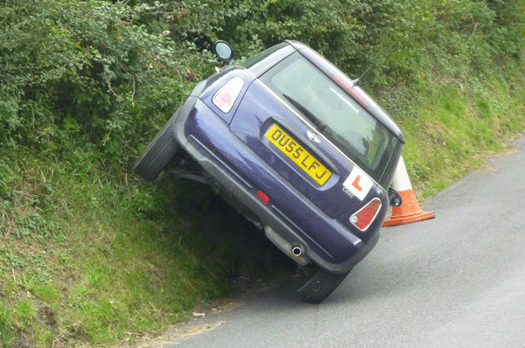
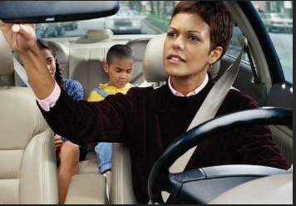
Modelling-the why
Because ‘real life’ has also repeatedly shown me that it matters…

Slide 6

Modelling-the why
Some pupils are exposed to far more modelling than others…
“If they do not see these examples, then we must rely on a child’s mental representation of excellent writing. Inevitably, only those whose writing is already advanced and well-honed will have this”.
Tharby, Making Every Lesson Count

Slide 7
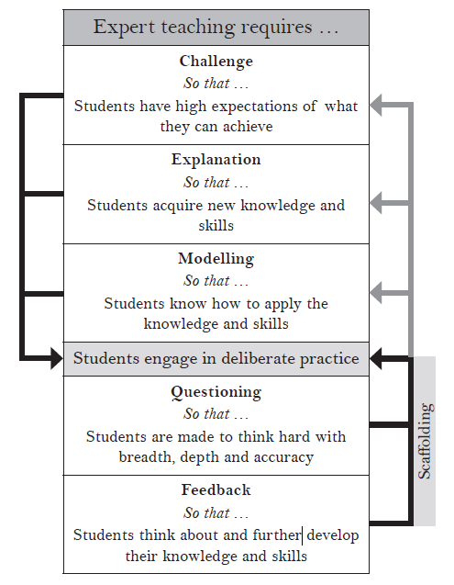
How does modelling fit into a lesson?

Slide 8
Why is modelling so hard?
1. The curse of knowledge “the problem is that when we know something very well we forget the stages we had to go through to learn it in the first place” The Art and Science of Teacher Explanation, Tharby.
2. The curse of not enough knowledge! To show and explain live in front of a class requires a high degree of subject knowledge, an excellent ability to explain and to articulate thinking whilst actually completing a task!

Slide 9
Improving my use of modelling-what did I do?
Read
Observe
Be observed
Tweak

Slide 10

What have I improved or introduced?
1. Explaining what I’m thinking
“since we can only process a limited amount of information at any one time, it is very important to avoid overloading attention with unnecessary or extraneous material” Cognitive load theory pg 52 Understanding How We Learn

Slide 11
Modelling-Explaining what I’m thinking
“Effective teachers will be able to narrate the decisions and choices they make: where to begin with a maths problem; where to start with an essay; how to plan the timing of a 20 minute writing task …by making the implicit explicit, teachers are supporting students to form their own mental models, gaining confidence with the decisions they make.”
Tom Sherrington, Rosenshine’s Principles in Action

Slide 12

What have I improved or introduced?
2. Not just modelling the opening

Slide 13
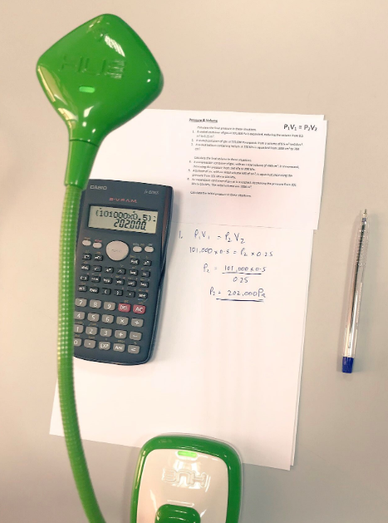
What have I improved or introduced?
3. Unpicking the model

Slide 14

What have I improved or introduced?
4. More modelling at Key Stage 5

Slide 15

What have I improved or introduced?
5. Modelling marking

Slide 16
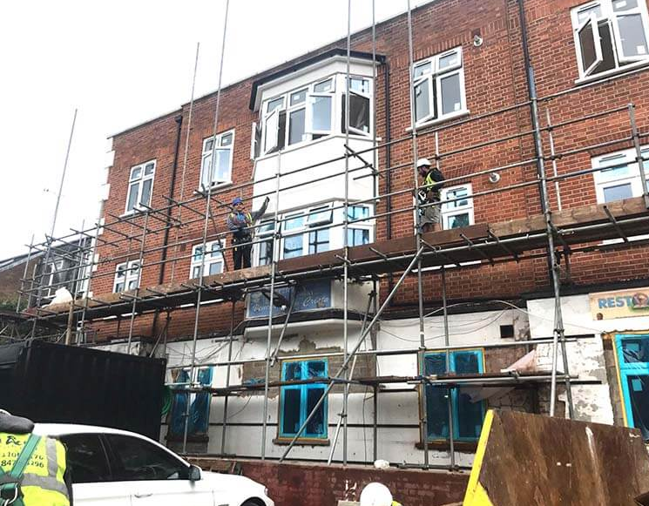
What have I improved or introduced?
6. How to remove the model

Slide 17
Modelling requires attention
“attention is a limited capacity resource…an important feature of our attentional mechanism is being able to selectively focus on just one location, object or message at any one point” Understanding How We Learn
And attention requires interest…
both individual and situational interest affect the extent to which we pay attention in a learning environment”. We are in control of situational not individual interest.
Situational interest we can control to some extent through “clear communication of ideas targeted at the right level of difficulty” (Rotgins Schmidt 2011) .

Slide 18

What do my lessons look like now?

Slide 19
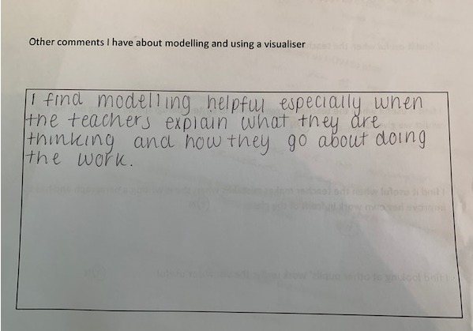
Live Modelling-The process
The process
I-We-You:
Teacher
All together
They do it on their own
Year 9 girl

Slide 20
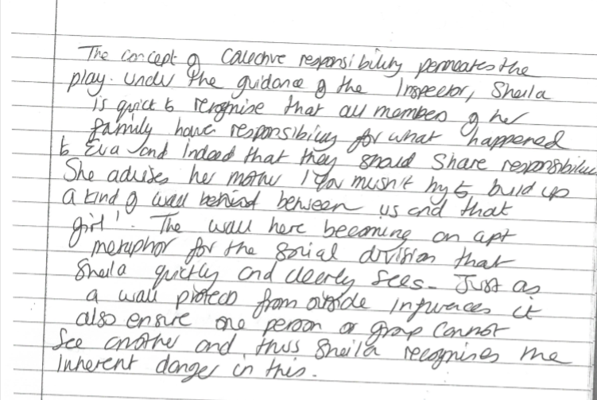
Live modelling-an example –teacher paragraph about responsibility in AIC–week 1

Slide 21
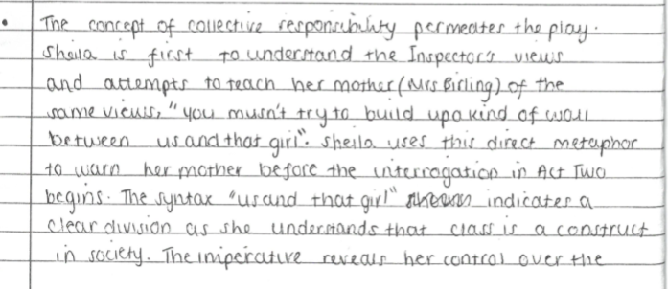
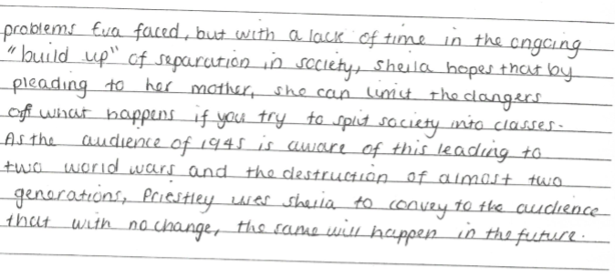
Pupil paragraph –week 3

Slide 22
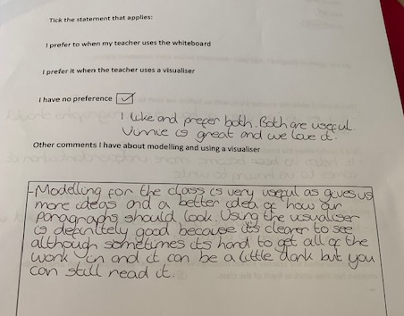
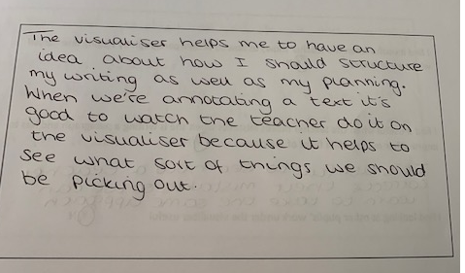
What do the students think?
Year 11 girl
Year 9 boy

Slide 23
What has been the impact of a year long focus on modelling?
Pupils’ results
knowledge of the assessment criteria
subject knowledge
My workload
behaviour

Slide 24
Live Modelling-The How
Works best when accompanied by you explaining your thought processes.
Allow them access to the mind of an expert!
Decide precisely WHAT to model and WHY.

Slide 25
Live modelling –top tips
Set the routine –I-we-you
Consciously model your thinking
New to a visualiser? Involve the pupils-think Vinnie!
Get a visualiser book(s)-absences and to plan/reflect.
Frequently show pupils’ work under the visualiser
Use the visualiser to demonstrate how you mark
Use the visualiser to demonstrate presentation expectations
Use the visualiser to ‘walk and talk’ a mock
Sit and work in an absent pupil’s space simultaneously with the students. Show your work under the visualiser and discuss.

Slide 26

What next?
Continue: modelling!
Stop: worrying about something going wrong.
Start: modelling more at key stage 5

Slide 27

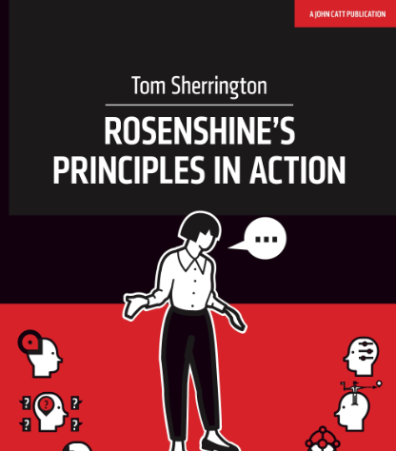

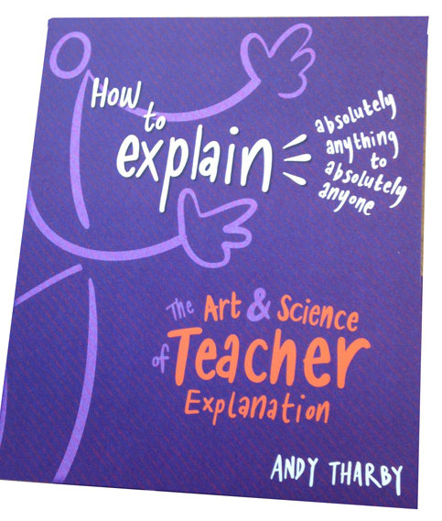
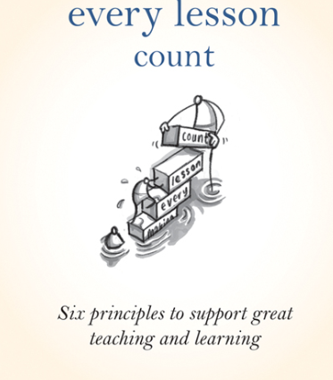

Some of the texts that have informed my thinking

